Slide 1
Electronic Health Records: A Teaching Tool
Loren Klingman
Nancy Meehan, PhD, RN
Roy Pargas, PhD
ACC Meeting of the Minds
April 17, 2010
Georgia Institute of Technology

Slide 2
Project Goal
Our creative inquiry (CI) team research seeks to discover if familiar environments can be used to teach new skills which can then be applied in an unfamiliar environment. For this project, the team chose to look at Electronic Health Record (EHR) software because few solutions currently exist for teaching students to use this complex software. The government is also mandating as a part of the American Recovery & Reinvestment Act that EHR software be used for all people by 2014. The team is creating software which looks similar to the familiar social networking environment Facebook but contains the major features nurses would use in commercial EHR programs. Our goal is to provide an educational EHR system in a familiar environment that acts as a stepping stone for the students to facilitate the transition from mere classroom knowledge about EHRs to actual use of a commercial EHR system in a hospital or doctor’s office. The team has recently conducted usability testing on nursing faculty and is presently focused on the skill set (competencies) necessary for EHR use.

Slide 3
Disclaimer
Not created to be a robust EHR
It is a teaching tool!

Slide 4
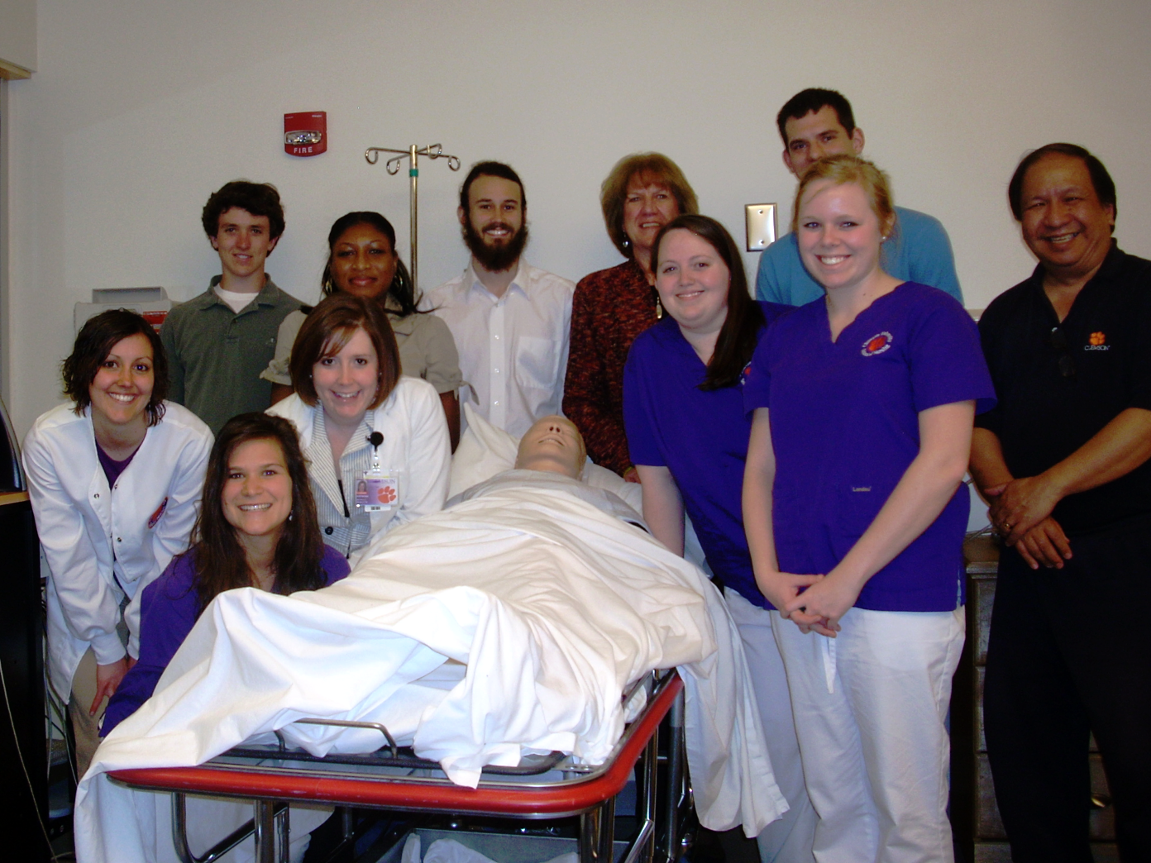
Creative Inquiry Team

Slide 5
Why is this EHR tool needed?
Lack of Availability to Commercial EHRs
High Cost of Training EHRs (~$50K for 3 years)
Government Mandate to Use EHRs as part of HIT (Health Information Technology)

Slide 6
Why is this EHR tool needed?
Need for an Educational Version of EHR System
Includes most important EHR concepts (as determined by Nursing faculty and Creative Inquiry students)
Includes authoring tool for faculty to design patient scenarios
Ability for faculty to provide feedback to student documentation
Scenarios can be saved and shared among faculty
Connected to Clinical Learning Research Center (CLRC)
Works with Tablet PCs and Patient Simulators

Slide 7
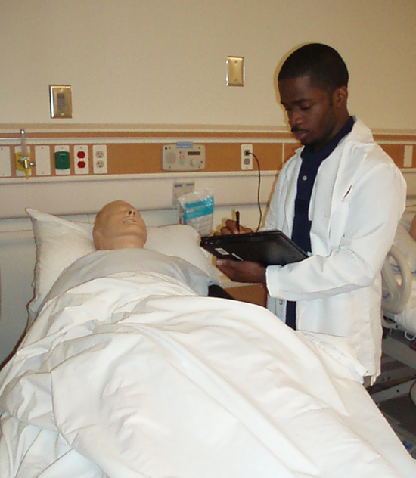
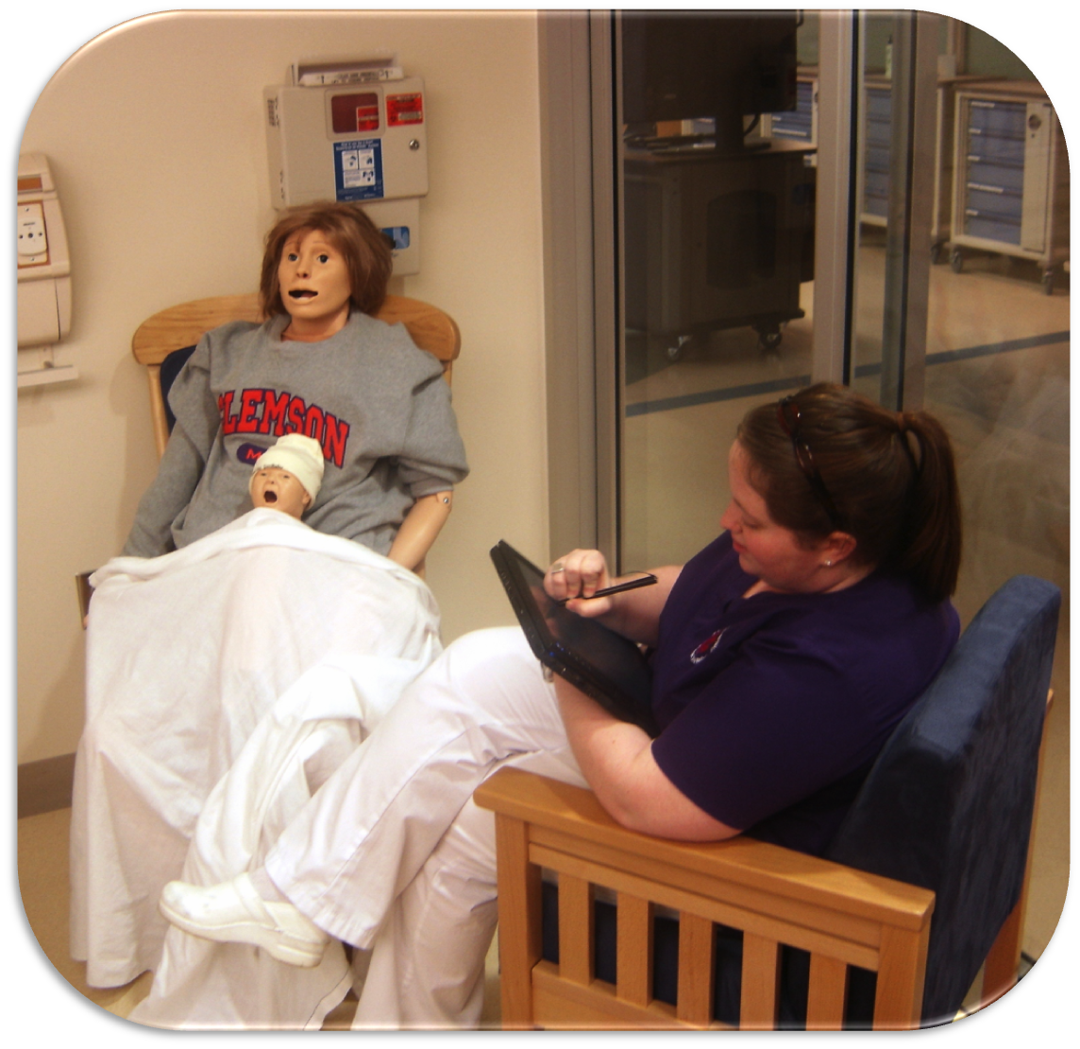
Clinical Learning Research Center

Slide 8
What is an “EHR”?
An electronic database of health care data about an individual
8

Slide 9
Components of our EHR
Many features that exist in commercial EHR systems
Vital signs
Medication Reconciliation
Lab Reports
Patient History
Authoring Tool for Patient Scenarios

Slide 10
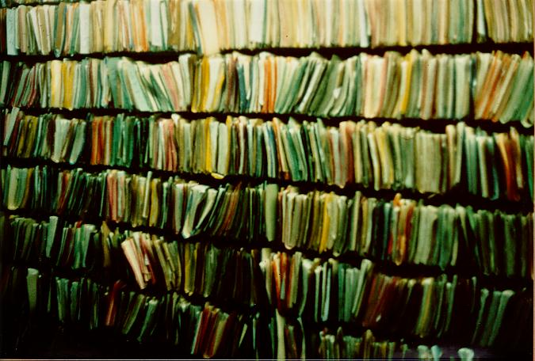
Paper Records

Slide 11
Tablet Computer at Bedside

Slide 12
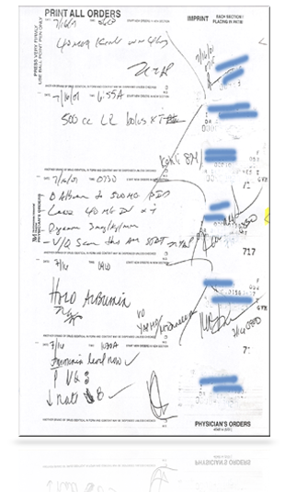
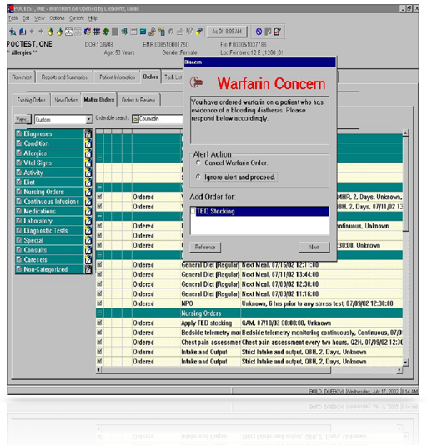
Transitioning from Paper to Digital Electronic Medical Records
PAPER
DIGITAL
© 2003 Cisco Systems, Inc. All rights reserved.

Slide 13
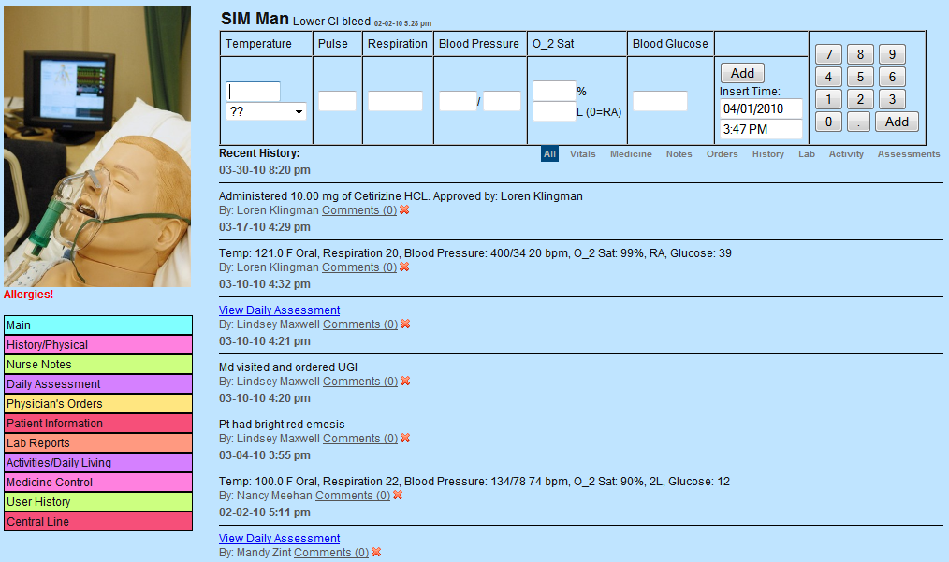
EHR Demo
http://www.clemson.edu/ehr

Slide 14
Summary
Teaching tool developed by Creative Inquiry students for nursing students
Transition into commercial EHR use made easier
Collaborative project between School of Nursing and School of Computing
EHR tool includes:
Medication reconciliation
Patient data entry
Patient scenarios (developed by faculty)
Ability for students to work in groups

Slide 15
Future Work
Usability testing with nursing faculty & students in Spring 2010
Improvements made from feedback
Modular so can add new modules
Nutrition
Adding more features
Tie into skills lab and patient simulators
Audit trail = guided walk through
In classroom testing, Fall 2010

Slide 16
Acknowledgements
Thank Dr. Rosanne Pruitt, Director of Nursing, for purchasing tablet computers.
Creative Inquiry and Calhoun Honors College for supporting this collaborative project.

Slide 17
Questions

