Slide 1
Electronic Health Records: A Teaching Tool
Nancy Meehan, PhD, RN
Roy Pargas, PhD
Loren Klingman & Mandy Zint
Teaching with Technology Symposium
December 15, 2009
Clemson University

Slide 2
Project Goal
This project capitalizes on the familiar environment of social networking websites to teach students how to use electronic health records (EHRs).

Slide 3
Disclaimer
Not created to be a robust EHR
It is a teaching tool!

Slide 4
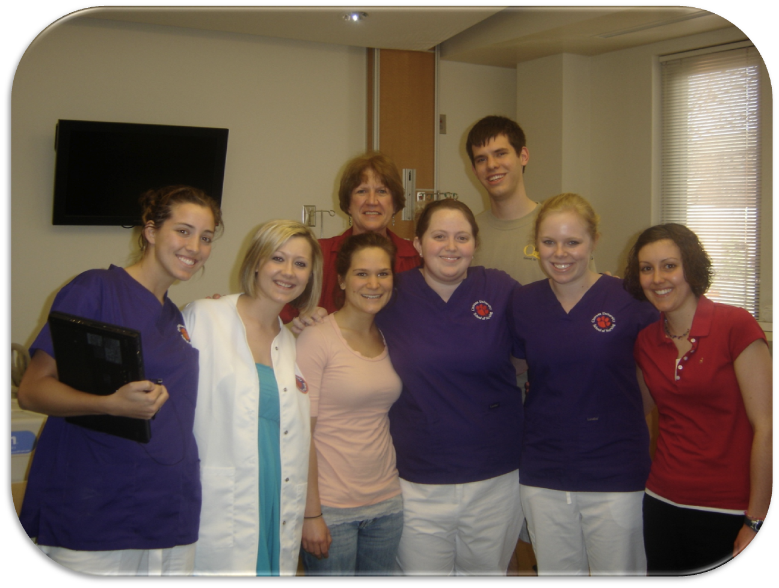
Creative Inquiry
+ 2009-2010 Members
2008-2009

Slide 5
Why is this EHR tool needed?
Lack of Availability to Commercial EHRs
High Cost of Training EHRs (~$50K for 3 years)
Government Mandate to Use EHRs as part of HIT (Health Information Technology)

Slide 6
Why is this EHR tool needed?
Need for an Educational Version of EHR System
Includes most important EHR concepts (as determined by Nursing faculty and Creative Inquiry students)
Includes authoring tool for faculty to design patient scenarios
Ability for faculty to provide feedback to student documentation
Scenarios can be saved and shared among faculty
Connected to Clinical Learning Research Center (CLRC)
Works with Tablet PCs and Patient Simulators

Slide 7
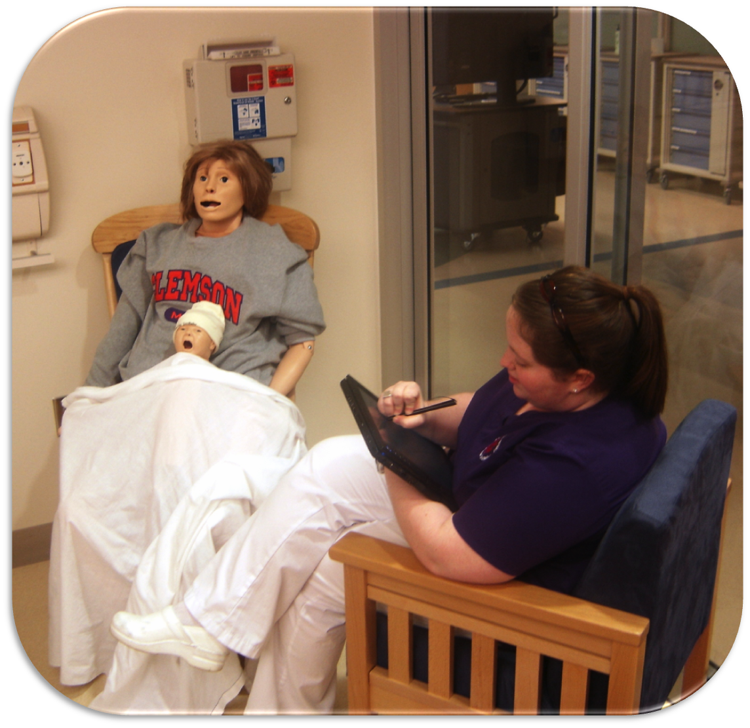
Clinical Learning Research Center

Slide 8
Why are we doing it?

Slide 9
Obama Stimulus Package

Slide 10
American Recovery & Reinvestment Act Eight Priority Technology Areas of Focus
Technologies that protect the privacy of health information and promote security in a qualified electronic health record, including for the segmentation and protection from disclosure of specific and sensitive individually identifiable health information
A nationwide health information technology infrastructure that allows for the electronic use and accurate exchange of health information
The utilization of a certified electronic health record for each person in the United States by 2014
Technologies that as a part of a qualified electronic health record allow for an accounting of disclosures made by a covered entity
The use of certified electronic health records to improve the quality of health care
Technologies that allow individually identifiable health information to be rendered unusable, unreadable, or indecipherable to unauthorized individuals
The use of electronic systems to ensure the comprehensive collection of patient demographic data, including at a minimum, race, ethnicity, primary language, and gender information
Technologies that address the needs of children and other vulnerable populations

Slide 11
What is an “EHR”?
An electronic database of health care data about an individual
Electronic Health Record
YouTube Video (NURS 140 students)

Slide 12
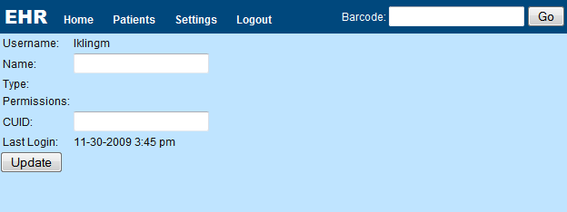
Components of our EHR
Format that students are familiar with e.g., Facebook

Slide 13
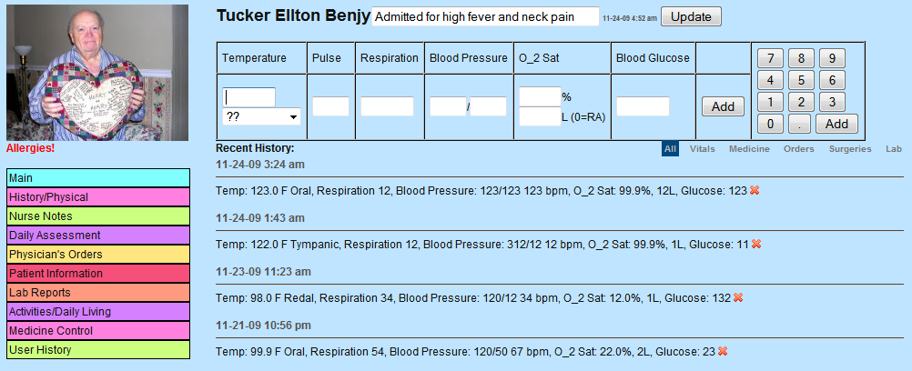
Components of our EHR
Many features that exist in commercial EHR systems
Vital signs

Slide 14
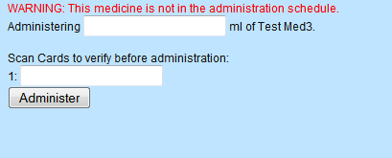
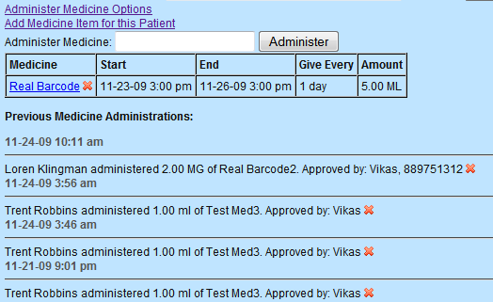
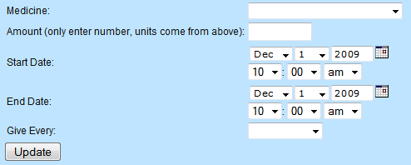
Components of our EHR
Many features that exist in commercial EHR systems
Medication reconciliation

Slide 15
Components of our EHR
Authoring tool for teachers to create patient scenarios

Slide 16
Paper Records

Slide 17
Tablet Computer at Bedside

Slide 18
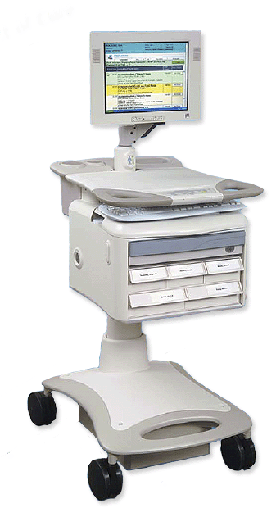
Hospitals Today
COW
(Computer on Wheels)

Slide 19
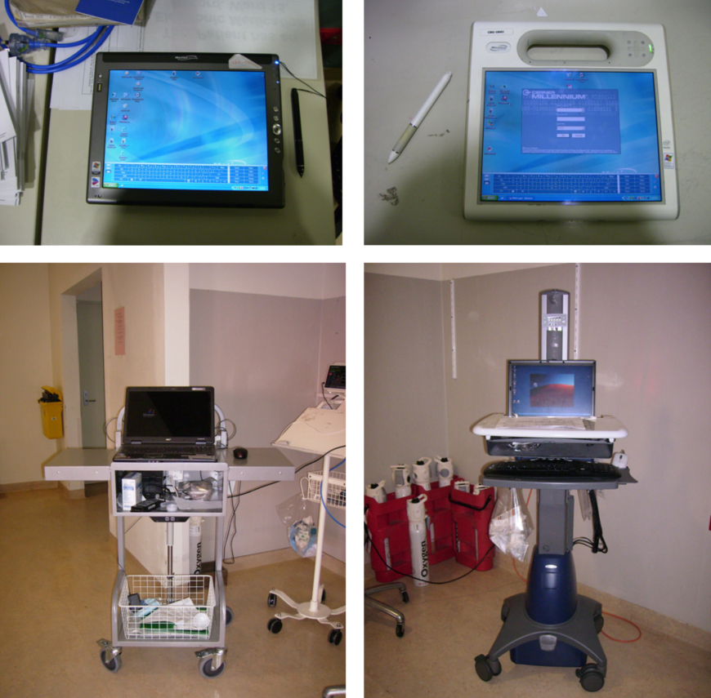
Hospitals Today

Slide 20
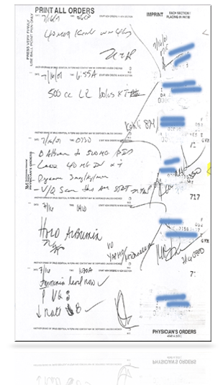
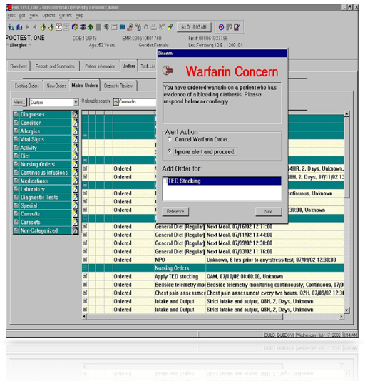
Transitioning from Paper to Digital Electronic Medical Records
PAPER
DIGITAL
© 2003 Cisco Systems, Inc. All rights reserved.

Slide 21
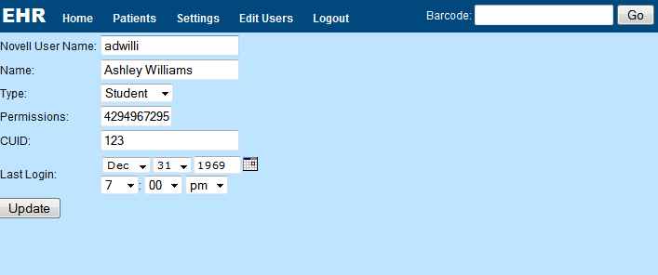
EHR Demo
http://www.clemson.edu/ehr

Slide 22
Summary
Teaching tool developed by Creative Inquiry students for nursing students
Transition into commercial EHR use made easier
Collaborative project between School of Nursing and School of Computing
EHR tool includes:
Medication reconciliation
Patient data entry
Patient scenarios (developed by faculty)
Ability for students to work in groups

Slide 23
Future Work
Usability testing with nursing faculty & students in Spring 2010
Improvements made from feedback
Modular so can add new modules
Nutrition
Adding more features
Tie into skills lab and patient simulators
Audit trail = guided walk through
Faculty ability to comment on student work

Slide 24
Acknowledgements
Thank Dr. Rosanne Pruitt, Director of Nursing, for purchasing tablet computers.
Creative Inquiry for supporting this collaborative project.

Slide 25
Questions

Slide 26
“Having Fun & Learning While Creating…”

